Slide 1
Software Design And Architecture (SE:2002)
Course Instructor: Romasha Khurshid
Email Address: Romasha.Khurshid@nu.edu.pk

Slide 2
Use-Case Diagram:
Popular technique for capturing functional requirements, especially in software development..
Use case diagrams model how stakeholder interact with the system.
This type of UML diagram should be a high-level overview of the relationships between users and systems
It can be a great tool for explaining your system to a non-technical audience.

Slide 3
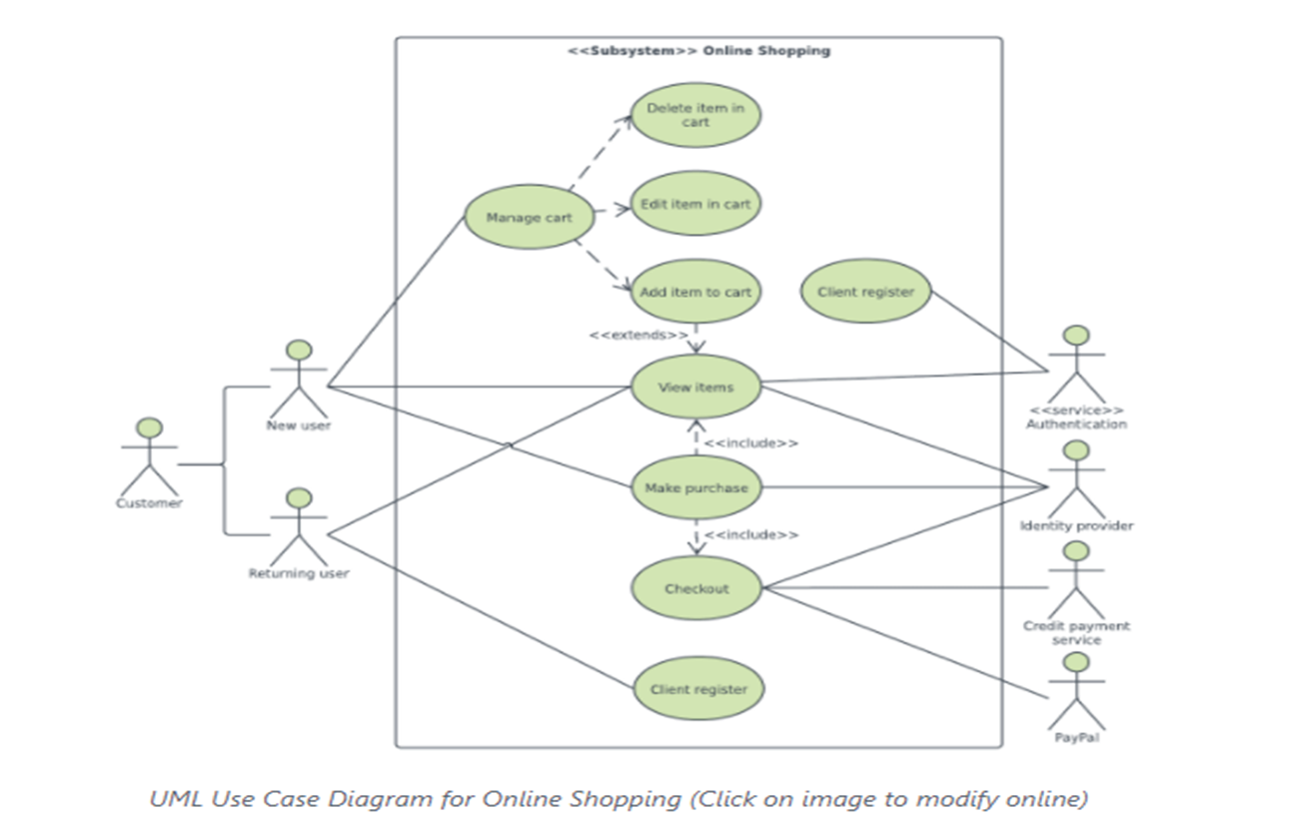
Purpose of Use Case Diagram:
Use case diagrams are typically developed in the early stage of development and people often apply use case modeling for the following purposes:
Specify the context of a system
Capture the requirements of a system
Validate systems architecture
Drive implementation and generate test cases
Developed by analysts together with domain experts

Slide 4
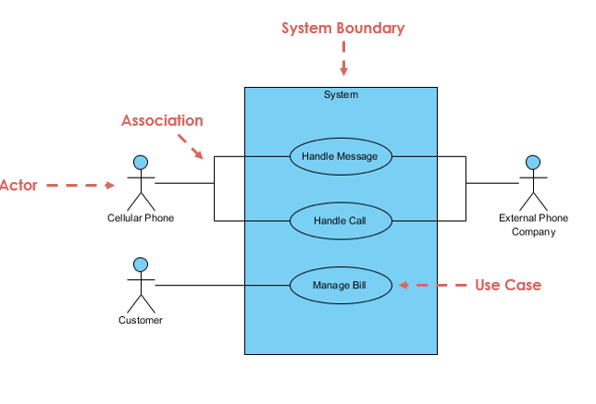
Elements of Use Case Diagram

Slide 5
1
Notation Description | Visual Representation
Actor Someone interacts with use case (system function). Named by noun. Actor plays a role in the business Actor has a responsibility toward the system (inputs), and Actor has expectations from the system (outputs).

Slide 6
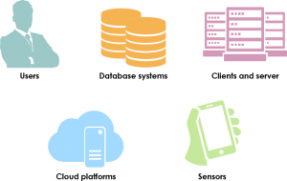

Types Of Actors:
Tips to identify actors…
Must serve as sources and destinations for data
Must be external to the system
Primary actor
has user goals fulfilled through using services of the system under discussion
drives the use cases
Supporting actor
provides a service to the system under discussion
e.g.,payment authorization service
implies: clarification of external interfaces and protocols needed.
Offstage actor
has an interest in the behavior of the use case, but is not primary or supporting
e.g., a government tax agency

Slide 7

2
Use Case System function (process - automated or manual) Named by verb + Noun (or Noun Phrase). i.e. Do something Each Actor must be linked to a use case, while some use cases may not be linked to actors.

Slide 8
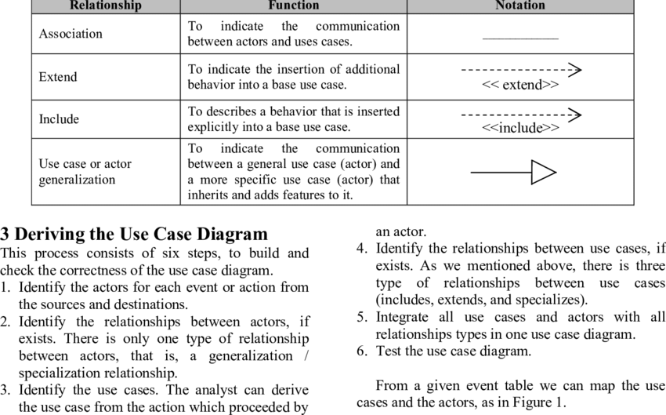
Relationship:
3
Types Of Relationship:

Slide 9

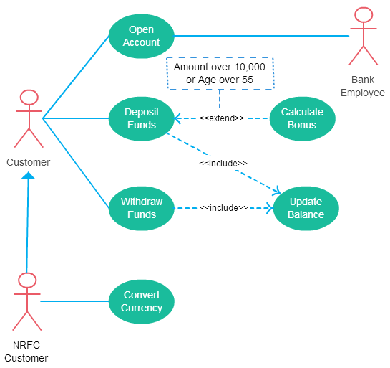
Relationships Examples…
Association Link
A Use Case diagram illustrates a set of use cases for a system, i.e. the actors and the relationships between the actors and use cases.
Include Relationship
The include relationship adds additional functionality not specified in the base use case.

Slide 10
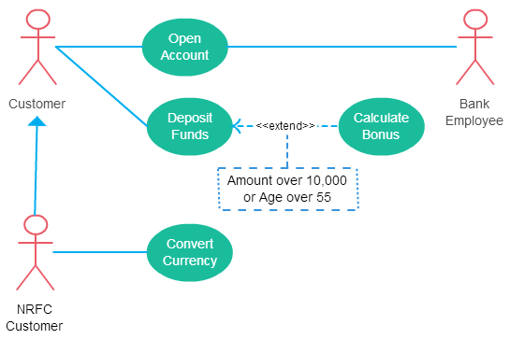
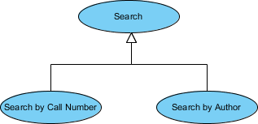
Continue….
The extend relationships are important because they show optional functionality or system behavior.
A generalization relationship means that a child use case inherits the behavior and meaning of the parent use case. The child may add or override the behavior of the parent. The figure below provides a use case example by showing two generalization connectors that connect between the three use cases.

Slide 11
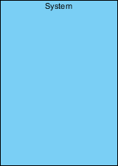
4
Boundary of system The system boundary is potentially the entire system as defined in the requirements document.

Slide 12
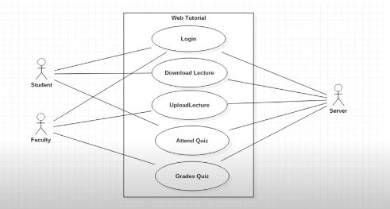
Example Use-Case

Slide 13
Use-Case levels:
Use-case can be written in different levels of detail. For example:
Brief use case:
A few sentences summarizing the use-case, usually the main success scenario.
one during early requirements analysis
should take only a couple of minutes
Casual use-case: multiple paragraphs
often used in agile because they easy, quick to write and understandable for both customer and developer
Main success Scenario: A customer arrives at a checkout with items to return. The cashier uses the POS system to record each returned items.
Alternate Scenarios: if the customer paid by credit. If the item identifier is not found in the system. If the system detects failure to communicate with the external accounting system .
3. Fully Dressed use case:
A carefully structured and detailed description enabling a deep understanding of the goals, tasks, and requirements. Used when system is complex and has high risks.

Slide 14
Detailed/Descriptive/Fully-Dressed Use-Case
Elements of a Use Case:
Use Case Name - Brief description. (Start with a verb)
Primary Actor – anyone or anything that performs a behavior (who is using the system)
Secondary Actor/ stakeholder– stakeholder who cares about this use-case.
Preconditions – what must be true or happen before and after the use case runs.
Post-Conditions - A list of conditions that must be true when the Use Case ends.
Triggers – this is the event that causes the use case to be initiated.
Main success scenarios [Basic Flow] – use case in which nothing goes wrong.
Extensions/Alternative flow – these paths are a variation on the main theme. These exceptions are what happen when things go wrong at the system level
Exception- Exception is anything that leads to NOT achieving the use case's goal. .
Quality- Specify quality attribute.

Slide 15
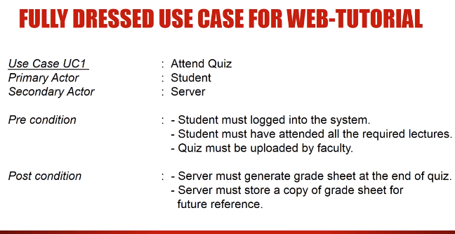

Slide 16
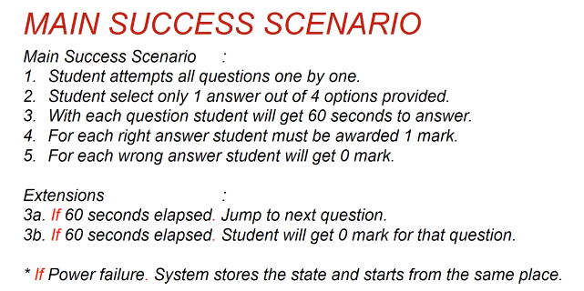

Slide 17
Exercise…
An executive at a chain of family restaurants called Brampton's Pizza
and Pasta.
They are looking to develop some software for in-house use at their restaurants.
Their goal is to take the restaurant ordering process and make it more efficient.
She is thinking that customers should be able to view the menu of the restaurant they're
in, and once they're ready, place an order.
she'd really like there to be a kids' page where you can see the kids' menu.
Maybe there's a few games for the kids to play, but most importantly,
it should be easy enough to use that kids can make an order themselves.
customers should also be able to specify any changes they'd like to make
for their meal, and they should be able to list any dietary restrictions they may
have before they submit their order to the kitchen.
The kitchen should then be able to view these orders as they come in.
Customers should be able to view and pay their bill within the system.

Slide 18
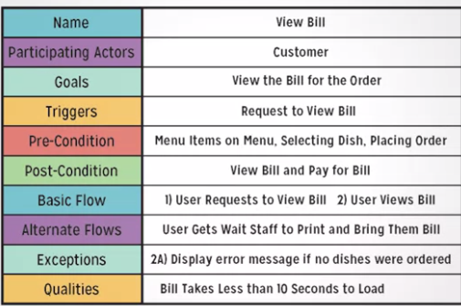
Solution…

Slide 19
Exercise…. Write a narrative Use case for booking a flight using UACAir app.:
UACAir allows passenger to select their domestic travel route. On entering their departure city, UACAir app populates options of arrival cities accordingly.
This tab takes departure and arrival airport details and then asks the passenger the number of
adult and child tickets, if it’s a round trip or one way trip.
If it’s a round way trip, the passenger then selects the departure and return dates. (UACAir throws
error if return date is smaller than departure date).
On pressing ok, all available flight schedules and details including airline details, price, departure
and arrival date time along with a confirmation button is shown.
The passenger then choose his desired flight(s).
The passenger then enters all passengers’ details based on the number of tickets chosen.
The confirmation button, UACAir app redirects passenger to payment section for the ticket(s)
purchase. UACAir only accepts payment through credit/debit card.
Once the payment has been done the itinerary will appear on UACAir my itinerary tab with the
travel plan details. The passenger can view their itinerary and itinerary will remain there till the
travelled date and time has passed.

